Slide 1
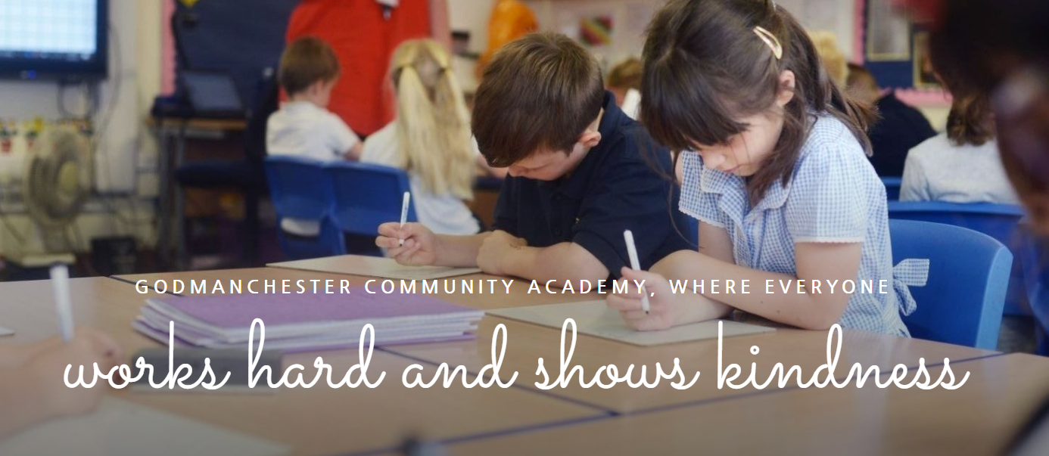

Slide 2
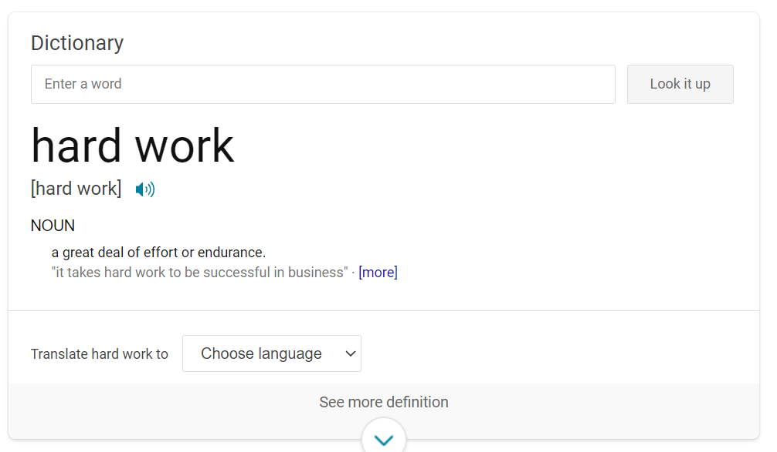
Hard Work

Slide 3
At GCA, what does hard work look like?
Trying your best all of the time - hard is work is about being consistent
Not giving up even when things are tricky - tricky things often require more work but once you master them you will be proud of your efforts.
Asking for help – we are here to help you achieve your best
Challenging yourself – stretch yourself out of your comfort zone
Remaining focused – ignoring distractions
Rehearsal or repetition –there are no shortcuts
Being self-motivated – working hard when no-one is watching
Anything worth achieving is worth working for.

Slide 4
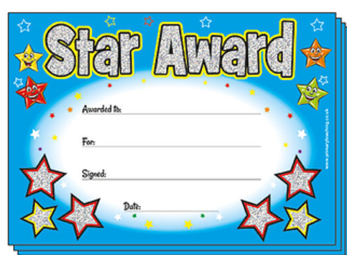


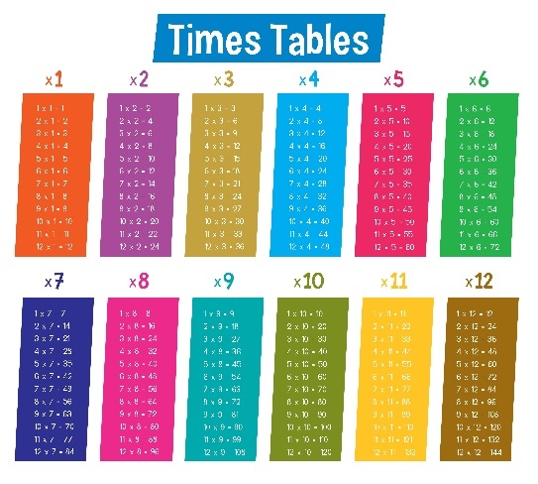

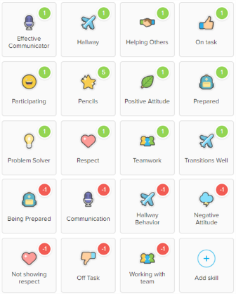
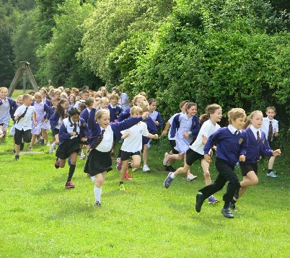
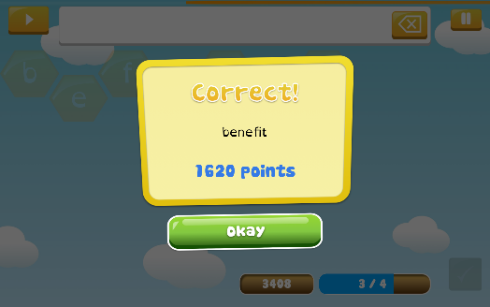



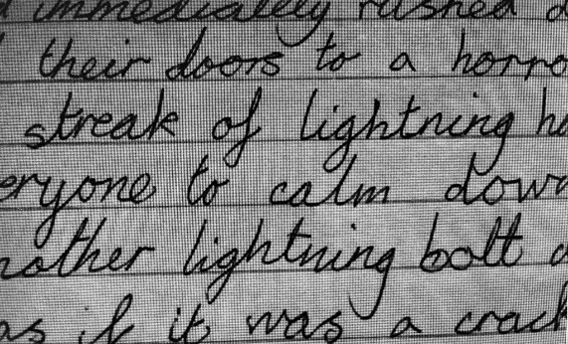
At GCA, what can you achieve with hard work?

Slide 5

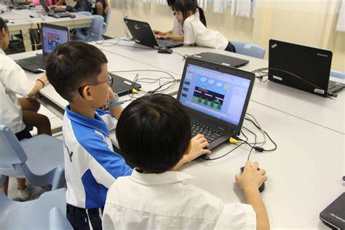
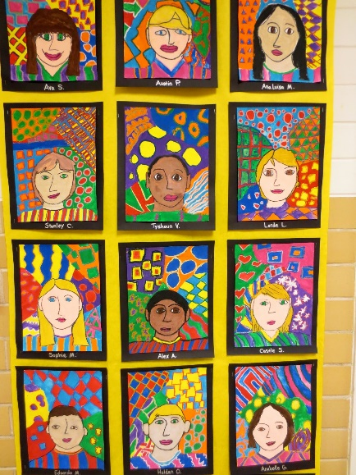
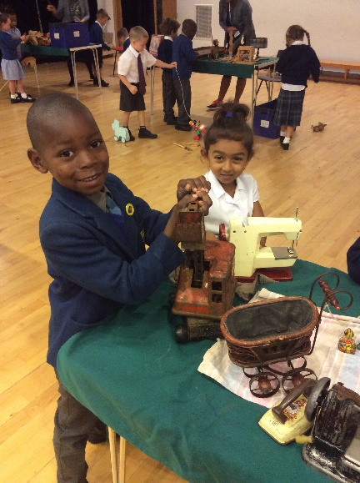
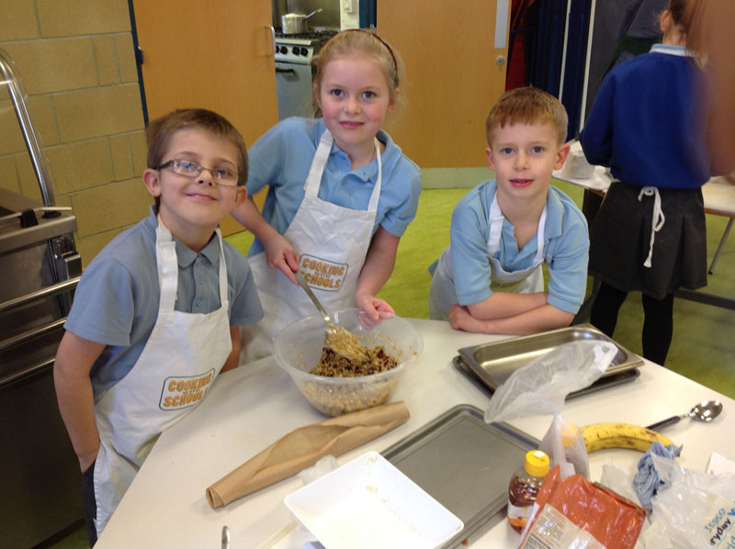
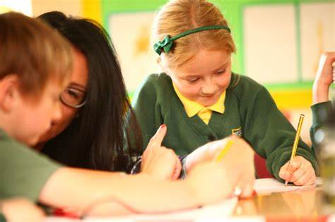
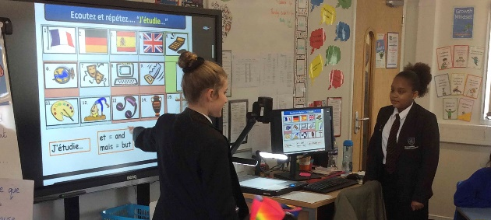
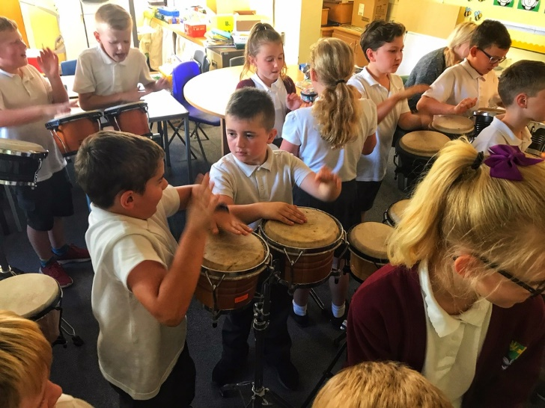
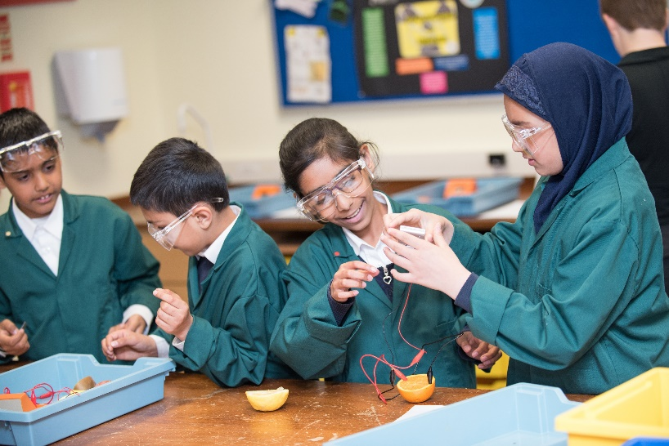
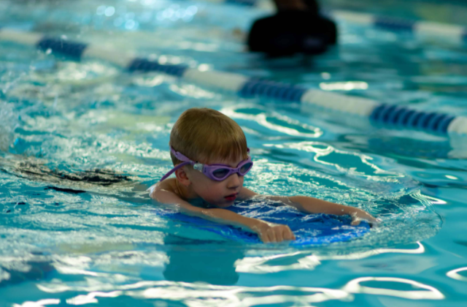
…and also…

Slide 6
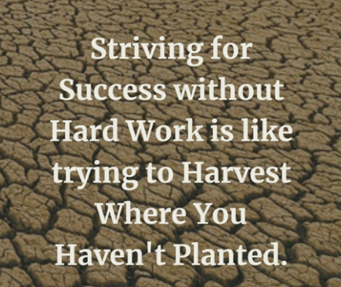

Slide 7
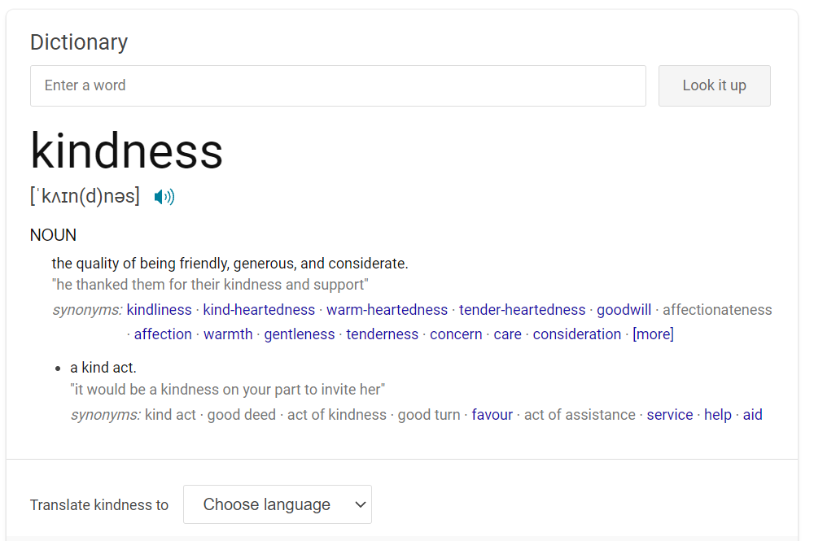
Kindness

Slide 8
At GCA, what does kindness look like?
Being friendly – smiling, asking people how they are, inviting others to play
Being understanding – celebrating everyone's uniqueness
Being considerate – thinking about other people as well as yourself, sharing, supporting, encouraging
Being respectful – caring about other people – staff and other children
No act of kindness, no matter how small, is ever wasted

Slide 9

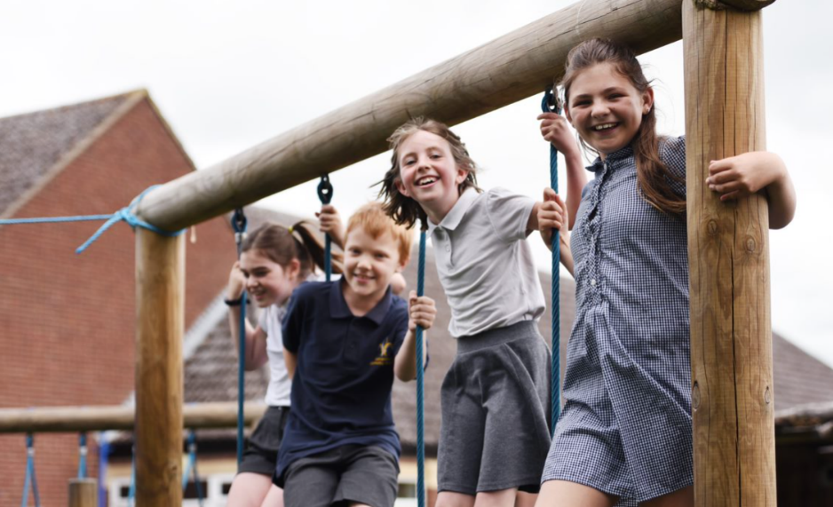
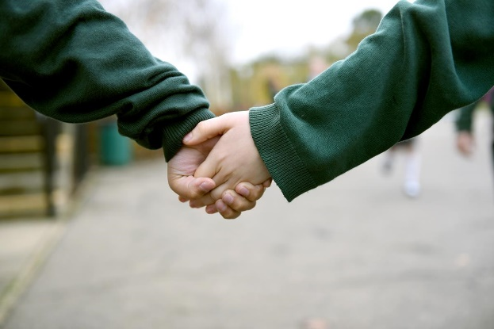
At GCA, what can you achieve with kindness?

Slide 10
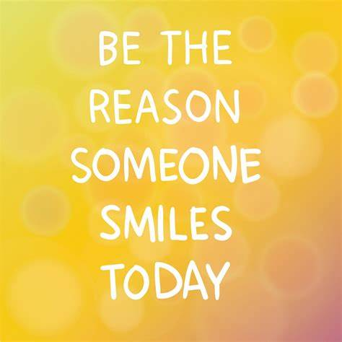

Slide 11
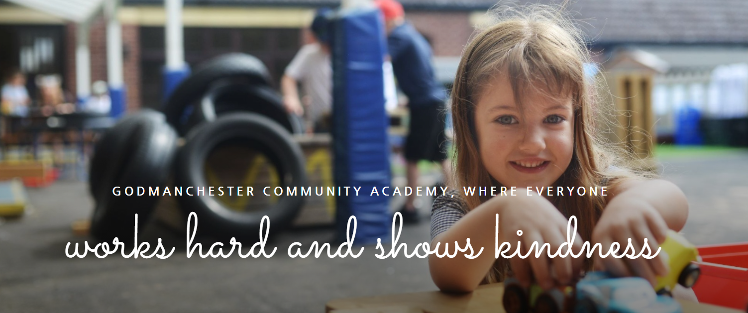

Slide 12
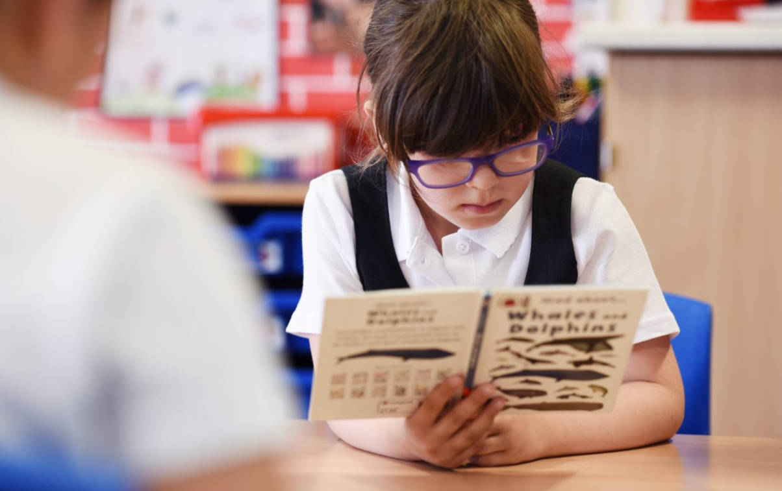
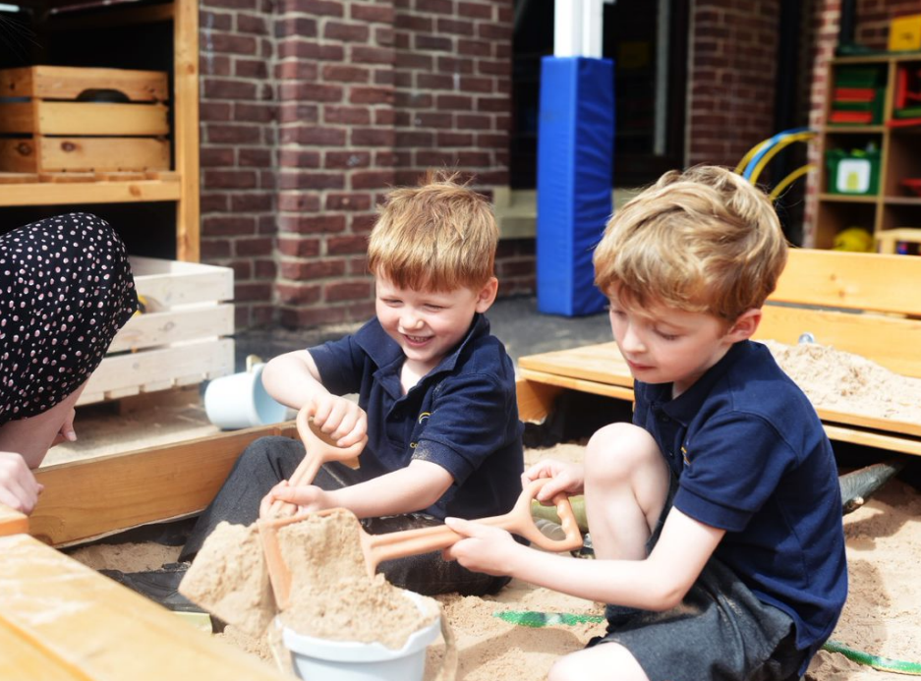
THE GCA WAY…
… we work hard and show kindness.

Slide 13
I challenge you…
To make someone smile.
To practise something you find tricky.
The GCA way…we work hard and show kindness.

